Slide 1
Chapter 15 – Cluster Analysis
Data Mining for Business Analytics (3rd ed.)
Shmueli, Bruce & Patel

Slide 2
Clustering: The Main Idea
Goal: Form groups (clusters) of similar records
Used for segmenting markets into groups of similar customers
Example: Claritas segmented US neighborhoods based on demographics & income: “Furs & station wagons,” “Money & Brains”, …

Slide 3
Other Applications
Periodic table of the elements
Classification of species
Grouping securities in portfolios
Grouping firms for structural analysis of economy
Army uniform sizes

Slide 4
Example: Public Utilities
Goal: find clusters of similar utilities
Data: 22 firms, 8 variables
Fixed-charge covering ratio
Rate of return on capital
Cost per kilowatt capacity
Annual load factor
Growth in peak demand
Sales
% nuclear
Fuel costs per kwh

Slide 6
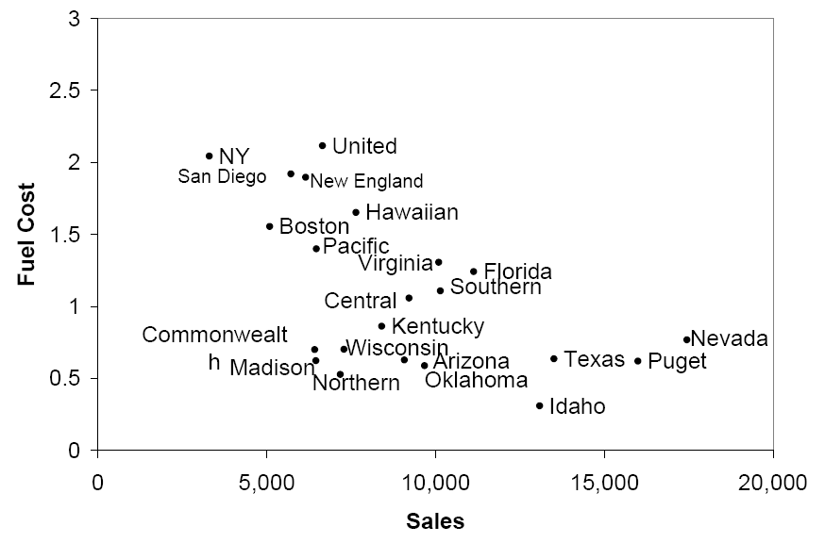
Sales & Fuel Cost:
3 rough clusters can be seen
High fuel cost, low sales
Low fuel cost, high sales
Low fuel cost, low sales

Slide 7
Extension to More Than 2 Dimensions
In prior example, clustering was done by eye
Multiple dimensions require formal algorithm with
A distance measure
A way to use the distance measure in forming clusters
We will consider two algorithms: hierarchical and non-hierarchical

Slide 8
K-Means Clustering

Slide 9
K-Means Clustering Algorithm
Choose # of clusters desired, k
Start with a partition into k clusters
Often based on random selection of k centroids
At each step, move each record to cluster with closest centroid
Recompute centroids, repeat step 3
Stop when moving records increases within-cluster dispersion

Slide 10
K-means Algorithm: Choosing k and Initial Partitioning
Choose k based on the how results will be used
e.g., “How many market segments do we want?”
Also experiment with slightly different k’s
Initial partition into clusters can be random, or based on domain knowledge
If random partition, repeat the process with different random partitions

Slide 11
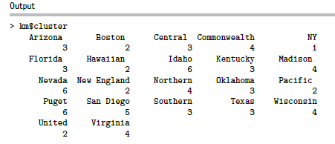
Code for K-means Clustering
(data prep as for hierarchical)
ask for 6 clusters
km <- kmeans(utilities.df.norm, 6)
# show cluster membership
km$cluster

Slide 12
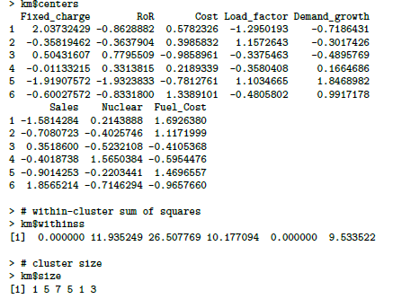
Cluster Characteristics
Centroids = each cluster has a vector of variable means
Custer 1 has normalized average demand growth of -0.7186
Clusters 1 and 5 are each singletons, so within-cluster distance = 0
number of utilities in each cluster

Slide 13
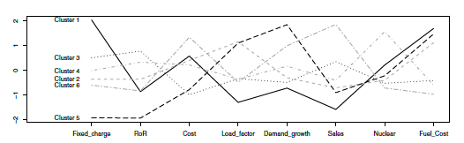
Visualize Cluster Centroids with Profile Plot
# plot an empty scatter plot
plot(c(0), xaxt = 'n', ylab = "", type = "l", ylim =
c(min(km$centers), max(km$centers)), xlim = c(0, 8))
# label x-axes
axis(1, at = c(1:8), labels = names(utilities.df))
# plot centroids
for (i in c(1:6))
lines(km$centers[i,], lty = i, lwd = 2, col = ifelse(i %in% c(1, 3, 5),"black", "dark grey"))
# name clusters
text(x = 0.5, y = km$centers[, 1], labels = paste("Cluster“, c(1:6)))

Slide 14
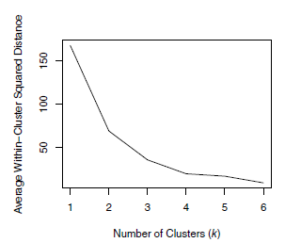
Different Choices for K
As the number of clusters increases, the cluster members are closer to one another.
Question: What happens to the distance between clusters?

